Slide 1
SMART CCTV CAMERA

Slide 2
Submitted to- Mr. Sanjay Roka
Submitted by- Priyanshi Mathur
University Roll no.- 2021966

Slide 3
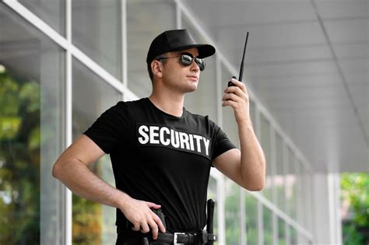

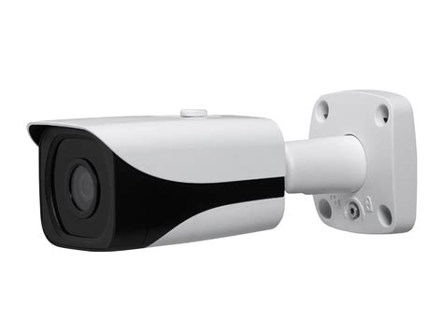
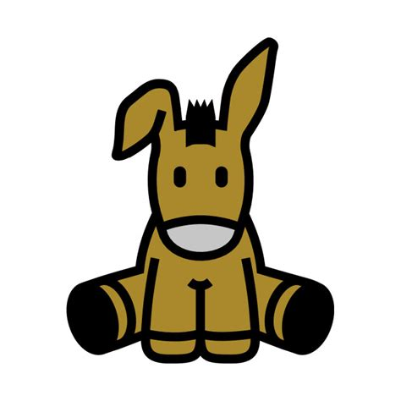
Traditional CCTV
Smart CCTV
Simply put, they are dumb
Whatever happen they just sit and watch.
Require human interaction to work properly.
Simply put it’s like a Security Guard
which has sense to respond.

Slide 4
Introduction
With the rapid advancement in technology, the demand for intelligent surveillance systems has increased significantly. Conventional CCTV systems are often limited by their reliance on manual monitoring, leading to delayed responses and missed threats. The Smart CCTV System aims to overcome these challenges by incorporating AI and real-time processing capabilities. This system not only ensures better safety and security but also optimizes resource utilization by minimizing human intervention. This is a python GUI application which can run on any operating system, uses webcam and has number of features. This is a Project built using latest Programming Language and highly evolving Computer Science field which is “Computer Vision”. Which means this project allow computer to watch or in other words it gives vision capability to computers.

Slide 5
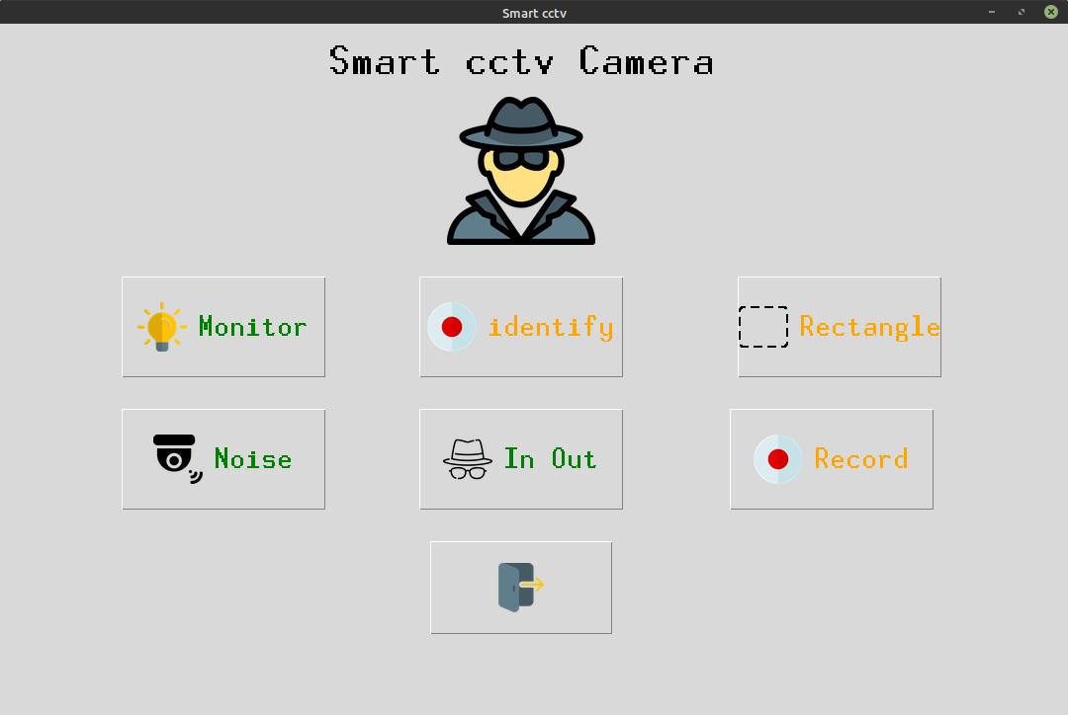
What smart cctv can do ?
What has been stolen ?
Do I know that person ?
Who entered?
Detect Noises ?
And ofcourse Record ...

Slide 6
Methodology
The development of the Smart CCTV System follows a structured approach to ensure effectiveness and reliability. Initially, diverse video datasets representing both normal and anomalous scenarios are acquired for model training and testing. Pre processing steps, including data cleaning and augmentation, are carried out to enhance model accuracy and robustness. Machine learning and deep learning algorithms, such as YOLO and Faster R-CNN, are employed for object detection, while behaviour analysis techniques focus on identifying anomalies. The developed models are then integrated into a real-time surveillance environment using edge computing devices and cloud infrastructure to ensure low-latency operation. Rigorous testing is conducted in various scenarios to validate the system’s performance, followed by incorporating feedback mechanisms to refine and improve the system continuously.

Slide 7
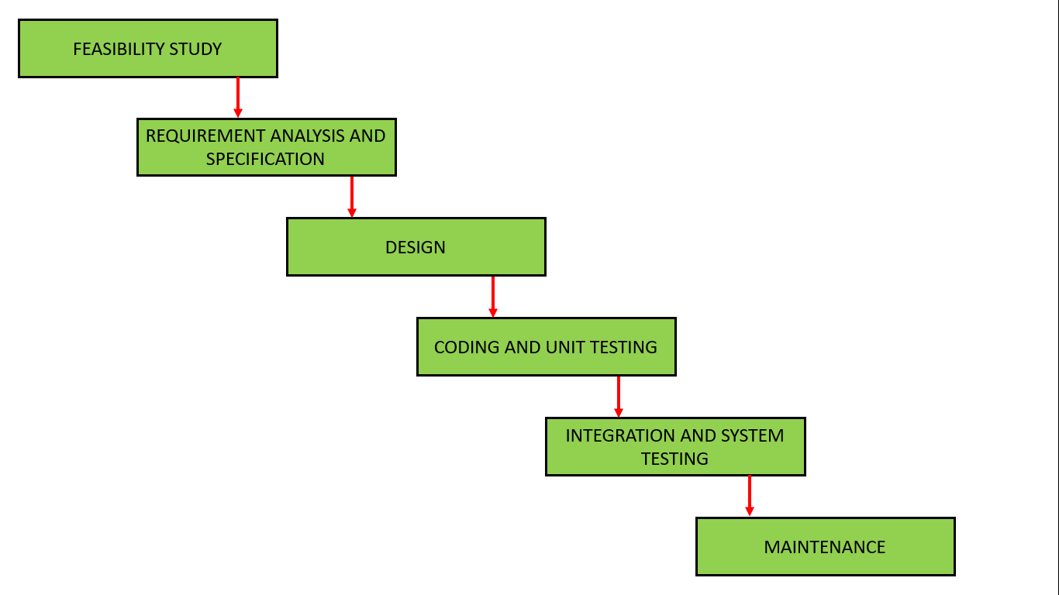
Result and Discussion
Below are the different features which can performed by using this minor project:
Anti-thief
Noise Detection
Visitors Counting
Recording
Face Identification
It got nice GUI and every button is supported by using
beautiful icon.
Monitor – allow to detect what thing is stolen from frame
Identify – Finds the family members (it has to be trained first)
Noise – Finds the motions in the frame

Slide 8
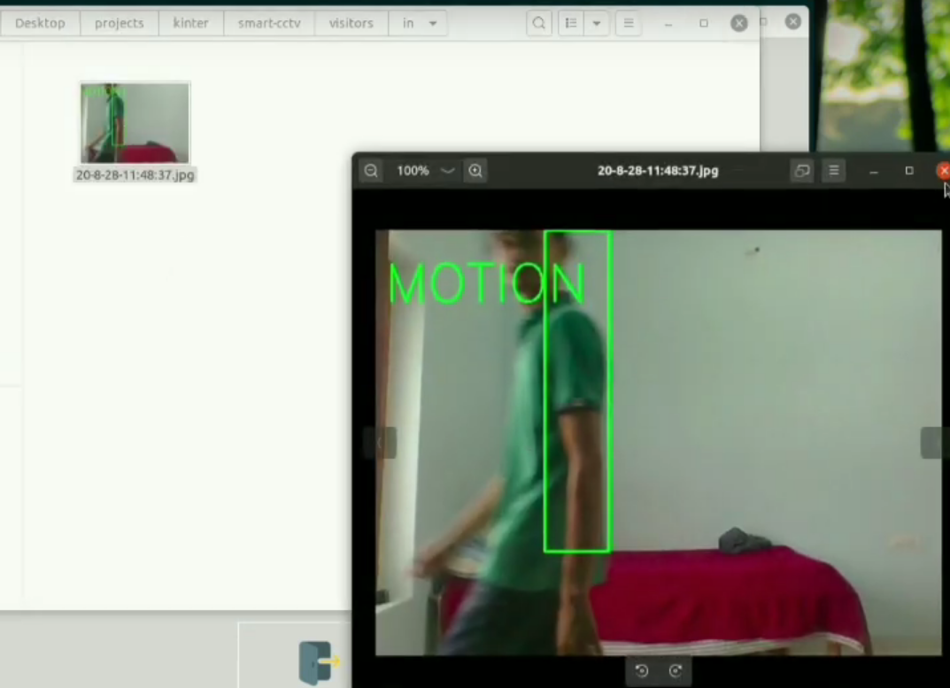
Who entered and exit ?
It just detect for noise in two ends {left, right}.
And follow the motion.
Click its picture and save.
It has detected me entering in the room
and being detected as entered and
saving the image locally.

Slide 9
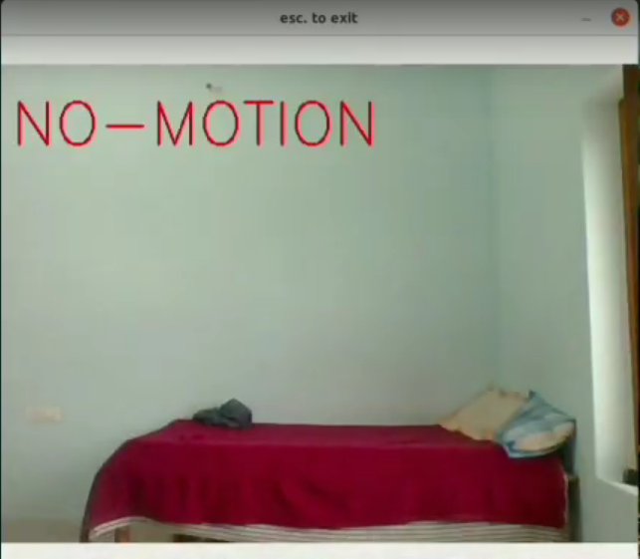
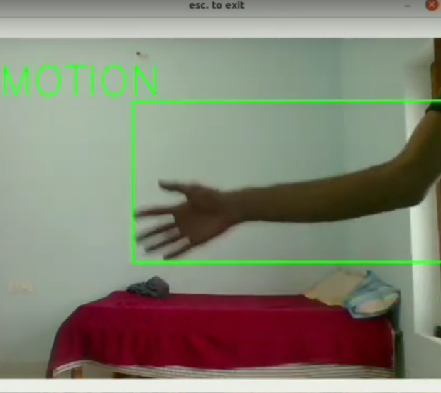
This is working captured output for NO-Motion and Motion being detected by this application.

Slide 10
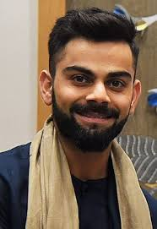
Identify me !
This feature allows to train the model on known circle of us.
Next time just predict who entered
Uses LBPHFace Identifaction method.
KOHLI
First Train the model with dataset.
Second Detect for faces in frames.
Then make prediction by using trained model

Slide 11
Conclusion and Future Work
Based On the technology improvements such being having the capability of small size but high processing power this project can be broadly used. Below are some future workout on this project.
Creating Portable CCTV.
Adding in-built night vision capability.
Adding deep learning if having high power device.
More feature such as
Deadly weapon detection
Accident detection
Fire Detection
much more.
Making stand alone application with no requirements such as python, etc.
Making standalone device.
Adding DL support would create broad scope in this project such as with DL we would be able to add up much more functionality.

Slide 12
References
For making this project we have used so many websites and papers and youtube tutorials all are below specified.
waterfall model geeksforgeeks
Structural Similarity from medium
face detection
LBPH algorithm
open CV
tech with tim
Also we have used so many other you tube channels and google and stack overflow to solve our errors.
Also we used Official python documentations to know basics about python.

